Slide 1
Design and Implementation of 64-point Fast Fourier Transform Chip
for OFDM
Members- Rahul Gaikwad(201EC221)
Madhunala Nikhil(201EC205)
Mentees: Aakash reddy, Prabhanshu Kumar, Arjun S Deginal

Slide 2
Introduction
Fifth generation wireless and mobile systems are currently the focus of research and development
Broadband transmission is based on OFDM, it will allow packet- based high-data-rate communication suitable for video transmission and mobile Internet Applications
we proposed a data path architecture using dedicated hardware for the base band processor using 64 point FFT algorithm

Slide 3
Objective
To design a 64-Point FFT chip.
Chip performs a forward and inverse 64-point FFT on a complex two-s complement data set in 23 clock cycles.
Less complex multiplication as compared with conventional radix-2 64-point FFT algorithm
To reduced power consumption

Slide 4
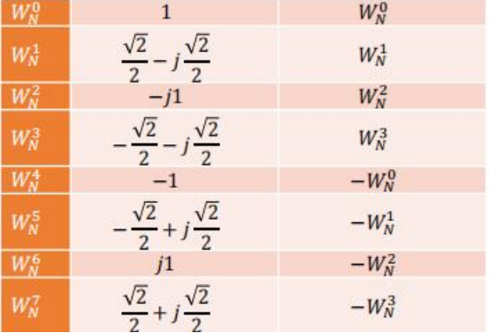


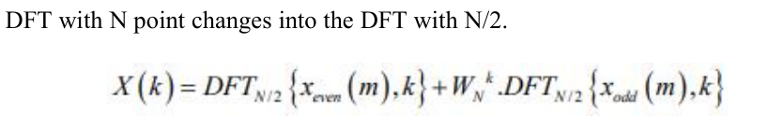
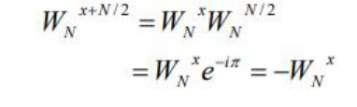
Methodology
DFT using FFT algorithm
The operation number needed for DFT is N^2 and it could be greatly reduced using FFT methods.
Twiddle factor for 8 point FFT

Slide 5
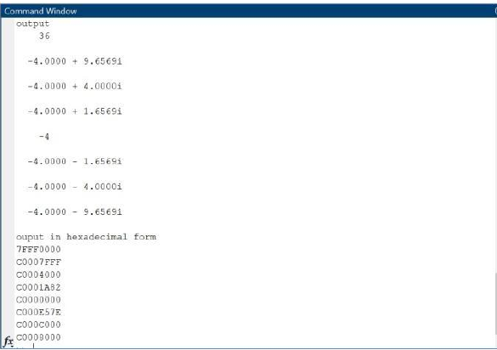
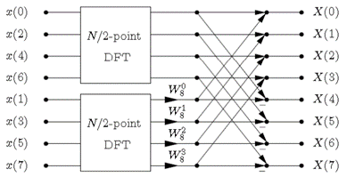
The Math Behind
8-point DFT graph for calculation of two DFT with N/2 points.
Matlab Simulation: 8 point FFT output

Slide 6
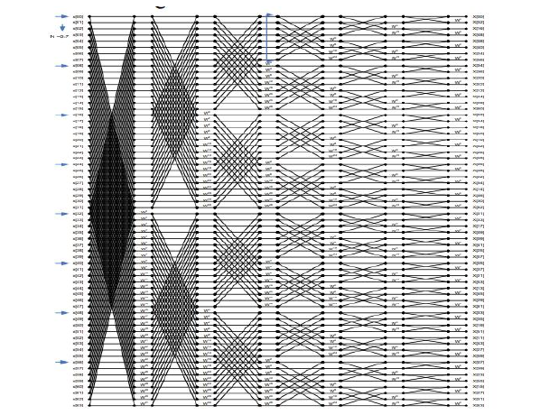
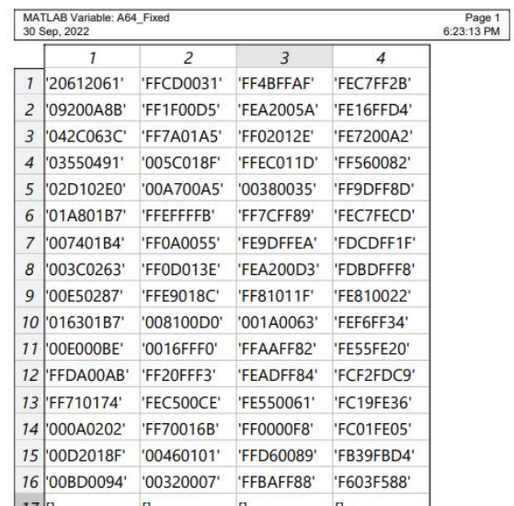
The completely decomposed 64-point DFT graph
Matlab Simulation: 64 point FFT output

Slide 7
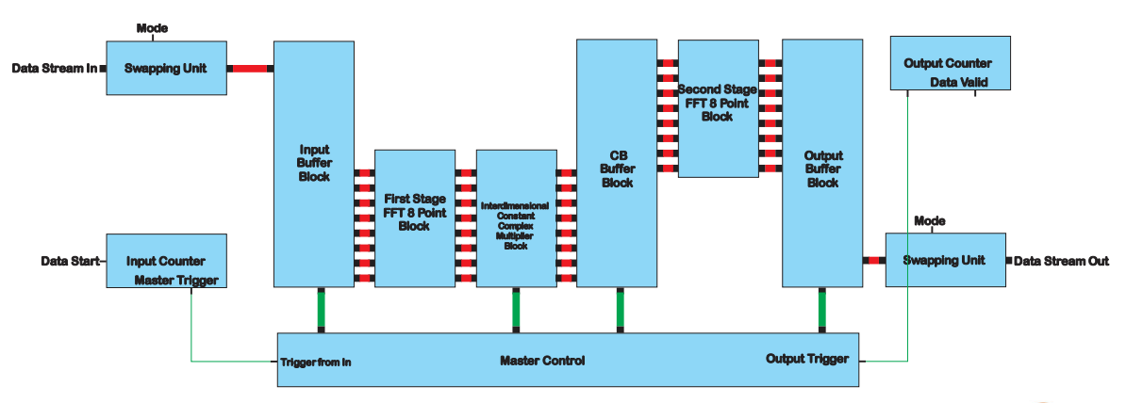
Architecture of Chip

Slide 8
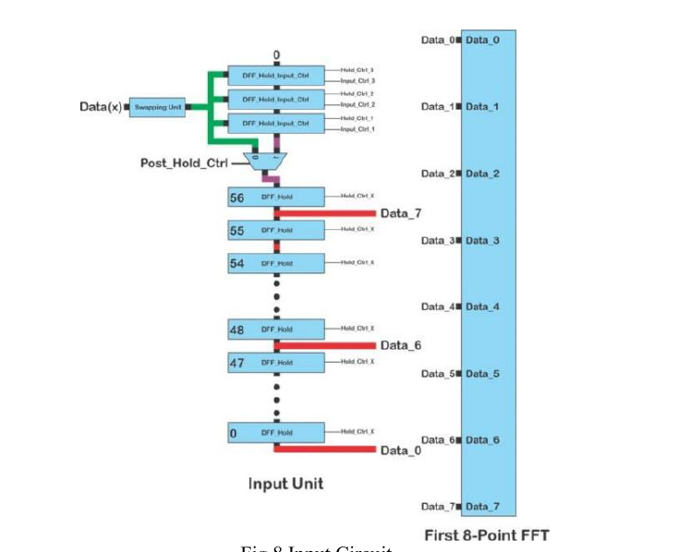
Input Circuit-

Slide 9
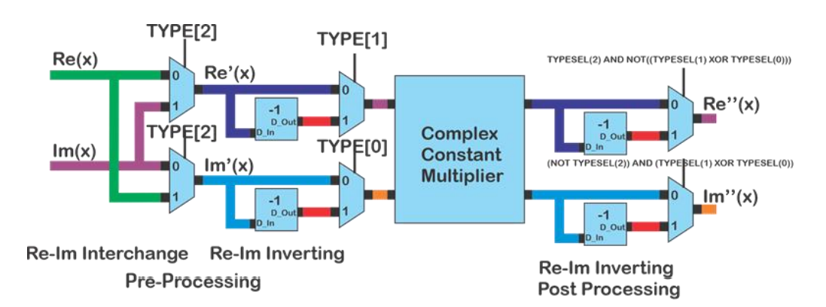
Multiplier Unit

Slide 10
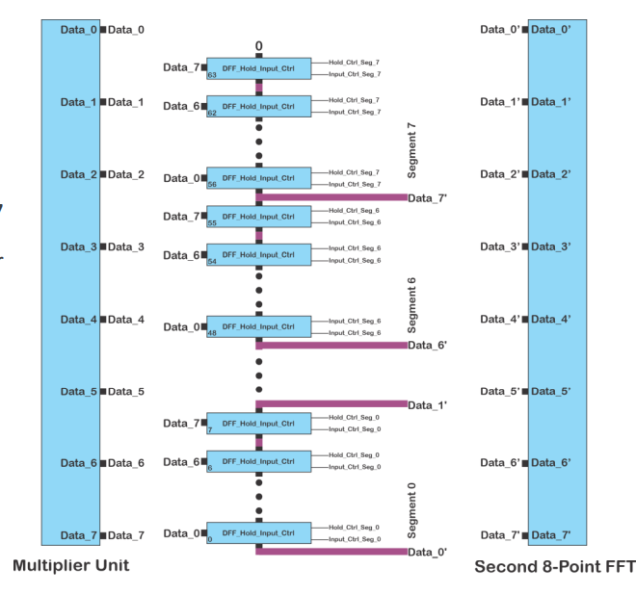
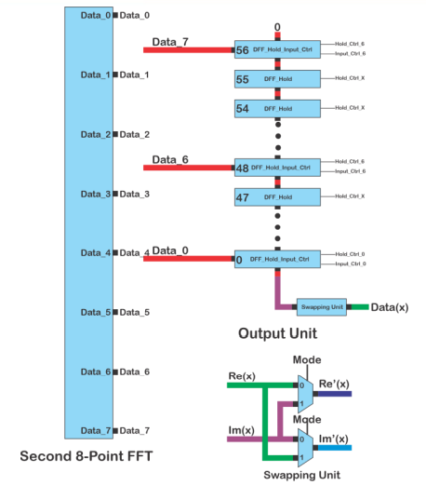
CB Unit and Output Unit
CB Unit
Output Unit

Slide 11
RTL Design using Verilog simulation-
The architecture was first modeled in Verilog and functionally verified using Quartus prime Modelsim simulator.
A clock frequency of 20 MHz is used
The latency of the processor is 3.85 s, i.e., 77 clock cycles
The parallel to parallel FFT/IFFT computation requires 1.15 s, i.e., 23 clock cycles.
After functional validation, the architecture was synthesized.
The synthesized cell area of the complete processor is 3.6 mm

Slide 12
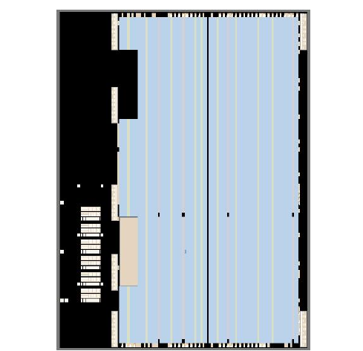
Die photograph of the fabricated 64-point FFT/IFFT processor

Slide 13
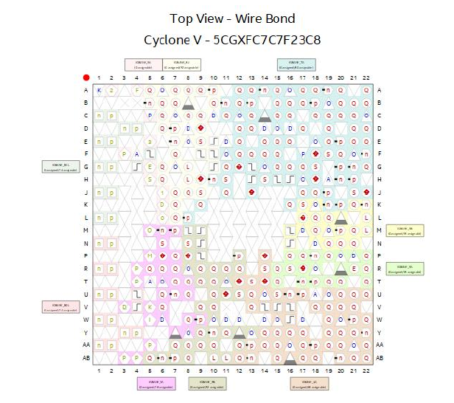
Pin Diagram and Implementation
The average power dissipation of the proposed 64-point FFT/IFFT design is 22.36 mW at20 MHz at 1.2V supply voltage.
Achieves low power and cost-effective feature.
The proposed 64-point FFT/IFFT design meets 3.2 μs timing specification
77 I/O pins where 8 pins are power supply pins

Slide 14
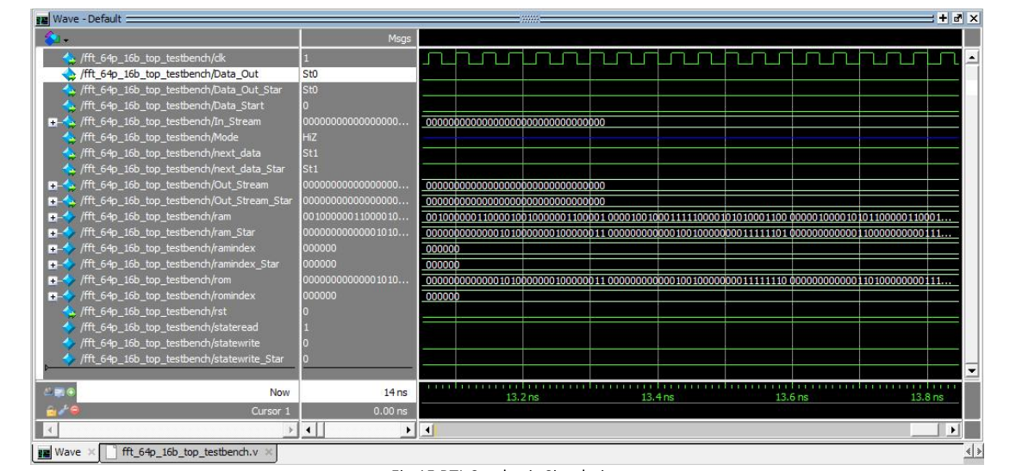
RTL Synthesis Simulation

Slide 15
Conclusion
Proposed method describes a novel 64-point IFFT/FFT architecture to be used in high speed WLAN system based on OFDM transmission.
This architecture consumes less silicon area and results in considerable reduction in cost.
Number of non-trivial complex multiplication are 49 that is 26% less than required by radix-2 64 point FFT.
For computation of IFFT/FFT full parallel scheme is adopted there by making it very fast.
With proposed design full parallel 64 point FFT/IFFT can be computed in 23 clock cycles.

Slide 16
Future work
Automatic place and Route
Analysis to be done for noise reduction
Synthesised and optimal solution
Reduce further silicon area and power decipation

Slide 17
References
1) K. Maharatna, E. Grass, and U. Jagdhold, "A 64-Point Fourier Transform Chip for High-Speed Wireless LAN Application Using OFDM," IEEE J. Solid-St. Circ., Vol. 39, No. 3, Mar. 2004
2) Implementation Of Efficient 64-Point FFT/IFFT Block For OFDM Transreciever Of IEEE 802.11a
3) A Low-Power 64-Point FFT/IFFT Design for IEEE 802.11a WLAN Application

Slide 18
Thank you!!

